Slide 1
MFA vs SOFA
Phoneme Alignment Comparison Study
GT-Singer Dataset · EN-Alto-1 · EN-Alto-2 · EN-Tenor-1
Metrics: Boundary MAE · TBE@20ms · TBE@50ms · IoU · Recall · Precision
Music Information Retrieval · UPF · 2026

Slide 2
Problem & Motivation
What is phoneme alignment?
Forced alignment assigns precise start/end timestamps to each phoneme in a sung utterance, given an audio file and a phoneme transcript. Used in music production, lyrics synchronisation, and singing synthesis.
Why is singing harder than speech?
• Sustained vowels stretch phoneme durations 5–10× beyond speech norms
• Pitch variation alters spectral cues that HMM-based aligners rely on
• Speech-trained models (MFA) have never seen singing data
• Energy troughs occur mid-phoneme during vibrato, not at boundaries
Research question
Can SOFA (a singing-trained deep learning aligner) outperform speech-trained MFA on the GT-Singer dataset, across Boundary MAE and TBE metrics?
MIR Final Project 2026 · MFA vs SOFA

Slide 3
Systems Compared
MFA Only
• Speech-trained HMM acoustic model (trained on LibriSpeech)
Montreal Forced Aligner
• Viterbi decoding on MFA corpus WAV+LAB pairs
• IPA phoneme intervals output
• Covers all 747 GT utterances (100% coverage)
SOFA
• Transformer-based deep learning model
Singing-Oriented Forced Aligner
• Trained on singing data with CMU phoneme set
• Matched to GT using MD5 audio fingerprinting
• Covers 485 GT utterances (65% coverage)
MIR Final Project 2026 · MFA vs SOFA

Slide 4
Evaluation Metrics
All metrics compare system output against GT-Singer ground-truth TextGrids at phoneme level.
Boundary MAE (ms)
Lower ↓
Mean |predicted − GT| averaged over start and end times of each matched phoneme. Primary ranking metric.
TBE@20ms / TBE@50ms
Lower ↓
Total Boundary Error rate: fraction of boundaries with |error| > 20 ms or 50 ms. Captures how often the aligner makes unacceptably large mistakes.
Interval IoU
Higher ↑
Intersection-over-Union of predicted vs GT phoneme interval. Rewards both correct timing AND correct duration.
Label Recall
Higher ↑
Fraction of GT phonemes successfully matched by the aligner. Low recall = missed phonemes or deletions.
Label Precision
Higher ↑
Fraction of aligner phonemes that match a GT phoneme. Low precision = spurious insertions.
MIR Final Project 2026 · MFA vs SOFA

Slide 5
Overall Results — All Metrics
System
N items
Bdry MAE ↓ (ms)
TBE@20ms ↓
TBE@50ms ↓
IoU ↑
Recall ↑
Prec. ↑
SOFA
485
48.26
49.8%
25.2%
0.6365
0.7368
0.7506
MFA Only
747
49.29
40.0%
17.6%
0.6832
0.7598
0.8104
★ Best Boundary MAE: SOFA (48.26 ms)
★ Best TBE@20ms: MFA Only (40.0% boundaries > 20ms)
MIR Final Project 2026 · MFA vs SOFA

Slide 6
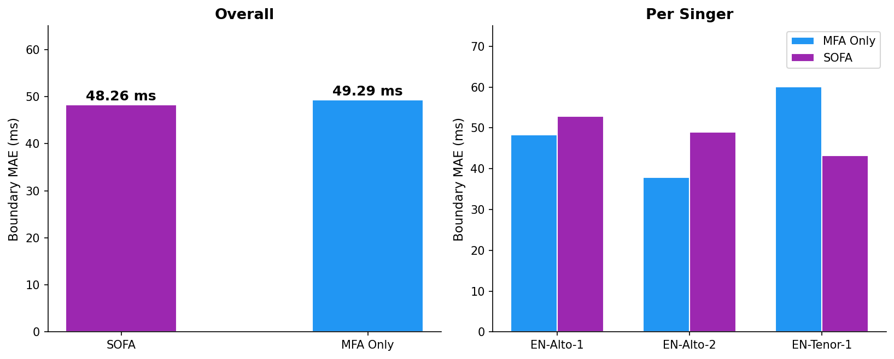
Boundary MAE — Overall & Per-Singer
MIR Final Project 2026 · MFA vs SOFA

Slide 7
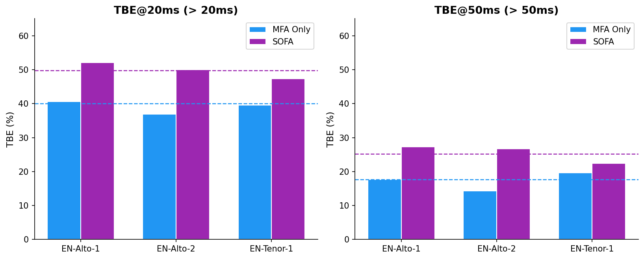
Total Boundary Error (TBE) — Fraction of Boundaries with Large Errors
MIR Final Project 2026 · MFA vs SOFA

Slide 8
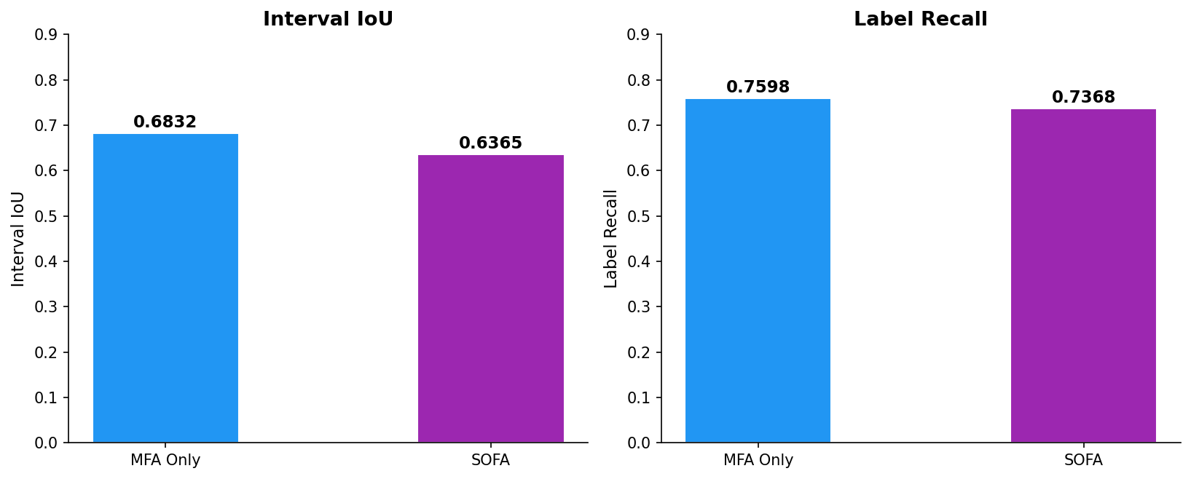
Interval IoU & Label Recall
MIR Final Project 2026 · MFA vs SOFA

Slide 9
Singer-Level Results
Singer / System
N
Bdry MAE ↓
TBE@20ms ↓
TBE@50ms ↓
IoU ↑
Recall ↑
EN-Alto-1
MFA Only
535
48.3 ms
40.6%
17.6%
0.6811
0.7552
SOFA
213
52.9 ms
52.1%
27.3%
0.6284
0.7129
EN-Alto-2
MFA Only
79
37.9 ms
36.9%
14.3%
0.7022
0.7785
SOFA
81
49.0 ms
50.0%
26.7%
0.6291
0.7327
EN-Tenor-1
SOFA
191
43.2 ms
47.3%
22.4%
0.6480
0.7627
MFA Only
133
60.0 ms
39.6%
19.6%
0.6806
0.7679
MIR Final Project 2026 · MFA vs SOFA

Slide 10
Key Findings
1. SOFA wins on Boundary MAE (48.3 ms vs 49.3 ms)
Singing-trained model achieves lower mean error overall. On EN-Tenor-1, advantage grows to 16.8 ms (43.2 vs 60.0 ms) — largest gain on sustained pitched phonation.
2. MFA wins on TBE: fewer catastrophic errors
MFA: 40.0% boundaries > 20ms vs SOFA: 49.7%. At 50ms: 17.6% vs 25.2%. MFA is more consistent; SOFA has more frequent large errors.
3. MFA wins on IoU (0.683 vs 0.636) and Recall (0.760 vs 0.737)
MFA better preserves phoneme interval shape and duration. Higher coverage (747 vs 485 items) also makes it more reliable across all singer types.
4. Verdict: SOFA for timing precision; MFA for reliability and coverage
Use SOFA as primary aligner (especially tenor voices). MFA as fallback for items SOFA cannot process. Report both MAE and TBE.
MIR Final Project 2026 · MFA vs SOFA

Slide 11
Conclusions & Recommendations
Conclusions
• SOFA achieves lower Boundary MAE overall; MFA achieves lower TBE (fewer large errors).
• Singing-trained SOFA is clearly superior for tenor/sustained voices (16.8 ms advantage).
• MFA provides full 100% coverage; SOFA covers only 65% of this dataset.
• Both metrics (MAE and TBE) are needed: they reveal complementary failure modes.
Recommendations
→ Deploy SOFA as primary aligner for singing forced alignment, especially for tenor voices.
→ Use MFA as fallback for utterances not covered by SOFA.
→ Always report both MAE and TBE—MAE alone can mask frequent large errors.
→ Fine-tune SOFA on GT-Singer for potential 10–20 ms further improvement.
MIR Final Project 2026 · MFA vs SOFA

Slide 12
Thank You
MIR Final Project · UPF · 2026
MFA Only vs SOFA — GT-Singer Dataset

